Slide 1


ANNUAL WORK REPORT 2024-25
JNANA PRABODHINI
SOCIAL SCIENCES STUDY CENTRE

Slide 2

WORK STATEMENT
01
To develop the holistic approach, comprehensive skills, and integrative attitude required for harmonious development (development with harmony of human being with self, family, society, nation, humanity and nature) in citizens through the study of social sciences and to create enabling structures and systems to support this vision.

Slide 3

02
OBJECTIVES
1
UNDERSTANDING THE INTERRELATIONSHIP AMONG DIFFERENT BRANCHES OF SOCIAL SCIENCES FOR UNDERSTANDING AND SOLVING COMPLEX NATIONAL ISSUES TO ACHIEVE HARMONIOUS DEVELOPMENT
2
UNDERTAKE COMPREHENSIVE STUDIES ON NATIONAL ISSUES AND CREATE LITERATURE TO FACILITATE MEANINGFUL DIALOGUE
3
CONDUCT RESEARCH AND SYNTHESISE SOLUTIONS TO PRESSING NATIONAL CHALLENGES
4
ENGAGE AND CONNECT YOUTH BY RAISING AWARENESS ABOUT NATIONAL ISSUES AND THE VISION OF HARMONIOUS NATIONAL DEVELOPMENT
5
BUILD THE CAPACITY, SKILLS, MINDSET, AND NETWORKS OF YOUTH TO CONTRIBUTE MEANINGFULLY TO HARMONIOUS NATIONAL DEVELOPMENT
6
DEVELOP AND PROMOTE THE IDEOLOGY OF ADHYATMIK RASHTRAYOG—A PERSPECTIVE ON INTEGRATED, HARMONIOUS AND SPIRITUAL DEVELOPMENT

Slide 4

AREAS OF WORK
03
1. Value-based approaches in economics
2. Interdisciplinary study of philosophy and consciousness
3. Exploring spaces of harmony across religions – social and economic dimensions
4. Use of technology for national and social problem-solving, rooted in human and societal
contexts
5. Connecting constitutional principles with cultural perspectives on nationalism

Slide 5

RESEARCH PROJECTS
The Centre is conducting ongoing research in the following areas:
04
1
Understanding the Economic Well-Being of Female Domestic Workers in Urban Pune: A Study for Inclusive Growth - This project is aimed to examine key aspects of the economic lives of female domestic workers in Pune, including income, expenditure, aspirations, concerns, financial capacity, access to market services and products, workplace environment, and related challenges. It began with a literature review, followed by the development of a questionnaire and pilot interviews. The project was later expanded by designing a questionnaire for employers of domestic workers and conducting pilot interviews.
2
Indian Fiscal Federalism: A Look at the Points of Contention – This project studied the allocation of revenue between the central and state governments through the Finance Commission, with a particular focus on the objections raised by southern states. It aimed to examine the facts behind these concerns.
The work is being further pursued through a more in-depth study and by writing blogs on the topic in a format that is accessible and understandable to the general public.

Slide 6

RESEARCH PROJECTS
The Centre is conducting ongoing research in the following areas:
05
3
Financial Literacy for Disadvantaged Groups: A Study on Rural Women: This project focused on exploring methods to assess the financial literacy of rural women. A literature review was conducted, and a questionnaire was developed.
4
Impact of AI on Accounting and Auditing: Focusing on the Chartered Accountancy Profession as part of the broader theme of AI’s potential impact on the economy, this project examined how Artificial Intelligence is influencing the fields of auditing and accounting. It involved a literature review, study of AI-based software, and interviews with industry experts. A questionnaire was also developed to survey professionals working in auditing and accounting.

Slide 7

STUDY GROUPS
06
1
Shri Aurobindo Study Group
Under the guidance of Mr. Vishwanath Gurjar, the group studied selected portions of the book ‘Human Cycle’ by Sri Aurobindo. In connection with this, first nine chapters of ‘Geetarahasya’ were studied and discussed. A recap and structured presentation of Chapters 1 to 9 was done by Mr. Amol Phalke and Mr. Chaitanya Bokil.
Dr. Girish Bapat conducted four sessions on the topic "Aadhyatmik Rashtrayog". A group of 36 interested participants has been formed to continue work on this theme. The transcripts of the lectures have been prepared and made available on the official website.
2
Data Analysis Study Group
This group is formed to help participants learn how to structure, analyze, and reinterpret data using tools like Python. It also aims to build a solid understanding of statistical concepts and develop the ability to apply statistical techniques effectively. The group is led by Dr. Aditya Ponkshe and Mr. Vedant Dixit.
3
International Relations and National Integration Study Group

Slide 8

INTERNSHIP PROGRAM
07
The Centre hosts summer interns from various colleges to provide research assistance on projects related to:
1. Socio-Economic Study of Domestic Workers
2. Indian Fiscal Federalism: A Look at the Points of Contention.
3. Financial Literacy for Disadvantaged Groups
4. Impact of AI on Accounting and Auditing: Focusing on the Chartered Accountancy profession
5. Study on the State Finance Commission to reduce the imbalance of regional development and promote equitable growth.
6. Union Budget Analysis to find the impact of personal income tax relief on individual and macroeconomic factors

Slide 9
CRITICAL THINKING - WORKSHOPS & COURSES
08
Sr. No. | Activity Type | Institution / Organization – Participants | Duration (Hours) | No. of Participants | Period | Trainers / Facilitators
1 | 2-Credit Course | Savitribai Phule Pune University – M.A. Journalism, First Year Students | 30 | 35 | Aug 2 to Oct 7, 2024 | Dr. Savita Kulkarni, Dr. Aditya Ponkshe, Dr. Deepak Gupte, Mr. Amol Phalke
2 | 2-Credit Course | D.G.V., Chennai College – Selected B.A. and M.A. Journalism Students | 30 | 50 | Feb 12 to Mar 30, 2025 | Dr. Savita Kulkarni, Dr. Deepak Gupte, Mr. Amol Phalke
3 | 2-Credit Course | Deccan Education Society, Pune – B.A. Psychology, First Year Students | 30 | 71 | Feb 18, 2025 – Ongoing | Mr. Amol Phalke
4 | Workshop | IIDL, Rambhau Mhalgi Prabodhini – Postgraduate Students (from 7 states) | 18 | 26 | Oct 9–10, 2024 | Dr. Savita Kulkarni, Dr. Aditya Ponkshe, Mr. Amol Phalke
5 | Workshop | IIDL, Rambhau Mhalgi Prabodhini – Postgraduate Students (from 7 states) | 12 | 26 | Feb 3–5, 2025 | Dr. Savita Kulkarni, Dr. Deepak Gupte, Mr. Amol Phalke
6 | Workshop | PG Diploma for School Psychology – Pragya Manassanshodhika Students | 9 | 27 | Mar 24, 25, 28, 2025 | Dr. Deepak Gupte, Mr. Amol Phalke
7 | Workshop | IISER, Pune – Faculty Training for Humanities and Social Sciences Teachers | 3 | 12 | Dec 30, 2024 | Dr. Savita Kulkarni, Mr. Amol Phalke

Slide 10

09
WORKSHOPS & SESSIONS
1
Union Budget Analysis –
a. The first session, Unlocking Budget, was conducted on 10th August 2024 by Mr. Piyush Ozarde and Ms. Vaibhavi Pingale, with 41 participants.
b. An activity-based workshop was held on 2nd February 2025, attended by 22 students.
c. A follow-up session on 23rd February 2025 featured student presentations on various aspects of the Union Budget and had 15 participants.
2
Sacred Economics – On 1st September 2024, Mr. Amol Phalke gave presentation on the book Sacred Economics by Charles Eisenstein as part of the ‘Sustainable Development Exhibition’ lecture series organized by G. Vasudev of Vivekananda Kendra.
3
Jnana Prabodhini Institute of Psychology - On 4th September 2024, Mr. Amol Phalke conducted a 2-hour session on SWOT Analysis for students of the PG Diploma in School Psychology, Institute of Pyschology
4
Social Responsibility and Teamwork – A four-hour workshop on Social Responsibility and Teamwork was conducted on 23rd September 2024 for the Centre for Social Action, Christ University, Pune. The workshop was attended by the student leadership team comprising 24 students (heads, sub-heads, and mentors from various cohorts – Education and Skill Development, Health, Hygiene and Wellbeing, Environmental Sustainability, Social Entrepreneurship, Media and Advocacy, and the Child Sponsorship Program) along with 2 mentors. The session was conducted by Mr. Amol Phalke and Dr. Deepak Gupte.

Slide 11

WORKSHOPS & SESSIONS
10
5
LAKSHY Fellowship – Workshops were conducted for LAKSHY Fellows, an initiative by Manaveeya Shiksha Shodh Sansthan, Parda, Buldhana, based on Madhyastha Darshan by A. Nagraj. The one-year fellowship program currently includes six fellows and focused on guiding them in Economics, Sociology, and Psychology. Two workshops were held at Jnana Prabodhini, Pune, in September–October 2024, attended by 10 participants (fellows and well-wishers). Additionally, an online Zoom meeting was conducted on 5th April 2025 to take updates and address queries related to their projects.
6
Stree Shakti Prabodhan – As a part of the Family System study camp organised by Stree-Shakti Prabodhan Karyadisha, Mr. Amol Phalke delivered a session on The Importance of Family System in the Changing Economic and Social Environment on 16th November 2024.
7
Mukta Vidya Kendra – In the Futurology study course organised by the Open Learning Centre, Jnana Prabodhini, Mr. Amol Phalke conducted sessions on Logical Framework Analysis and Introduction to Critical Thinking in February 2025.
8
Personal Financial Planning – A paid session (3 hours) was conducted on 22nd March 2025. The activity-based session was led by Mr. Amol Sugandhi and was attended by 21 participants, including 7 college-going students and 14 working professionals.

Slide 12
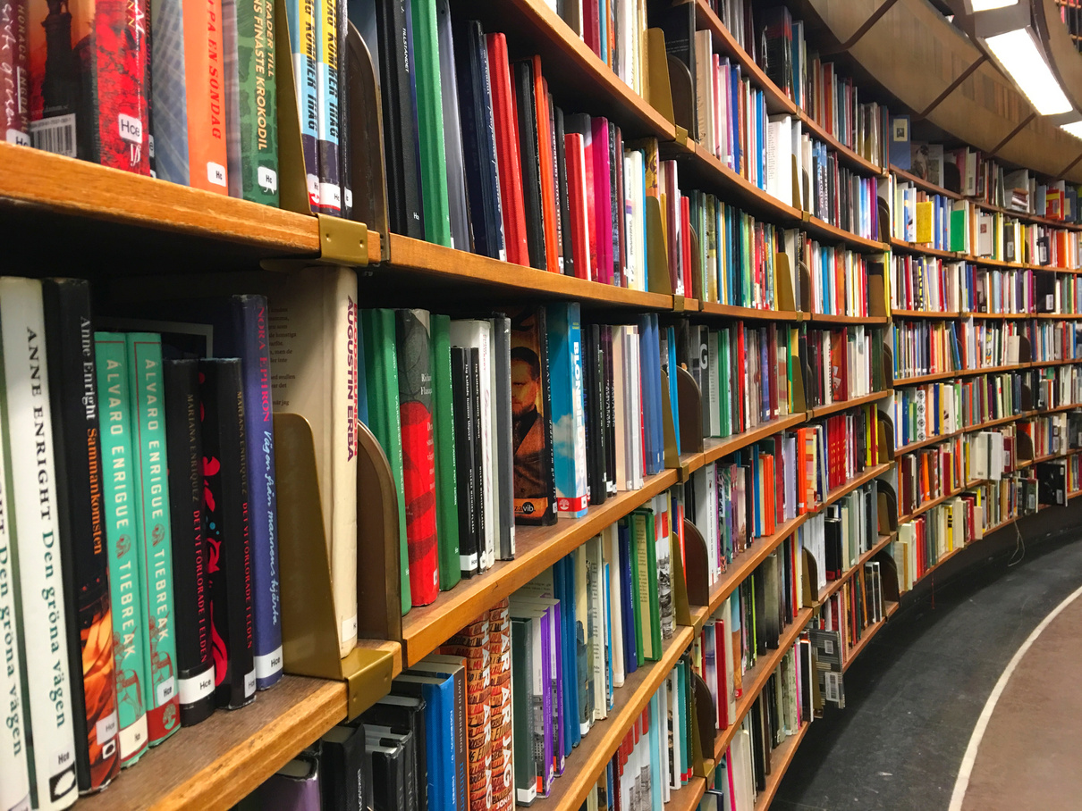

LIBRARY
11
The library was expanded with 28 new books relevant to key study areas and research projects of the Centre
LITERATURE CREATION
As part of the article series on National Integration under Chhatra Prabodhan, Mr. Shashishekhar Chougule wrote an article on Interdependence in the Production Systems of States.
Mr. Ishant Deshmukh wrote two blogs on revenue allocation between the central and state governments through the Finance Commission.
Mr. Amol Sugandhi wrote one blog on the topic of Personal Financial Planning.

Slide 13
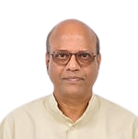
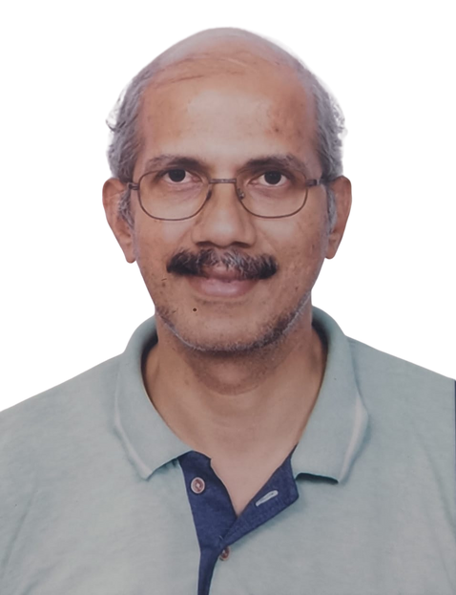
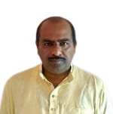
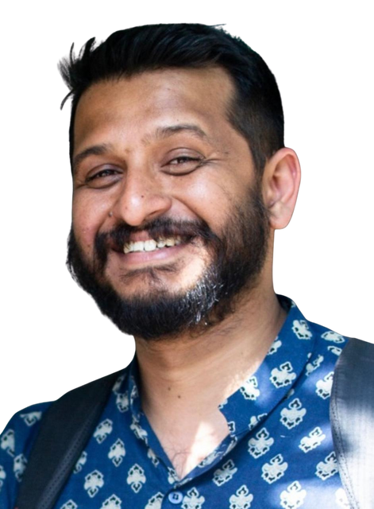
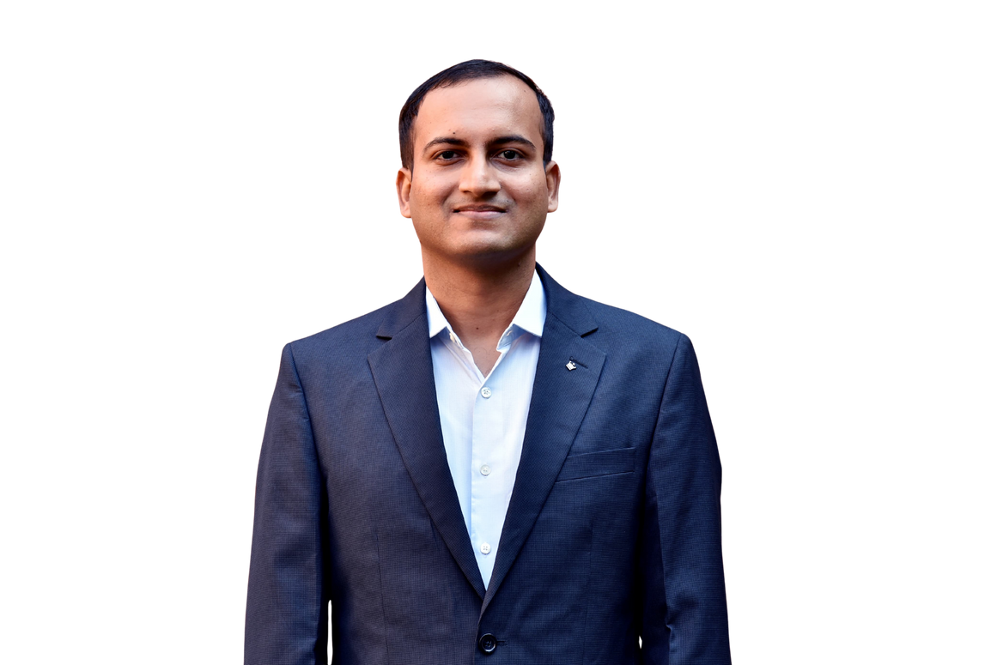
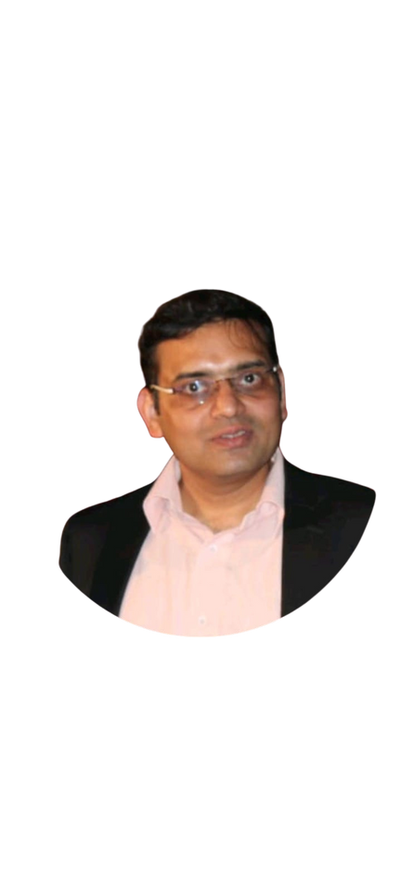
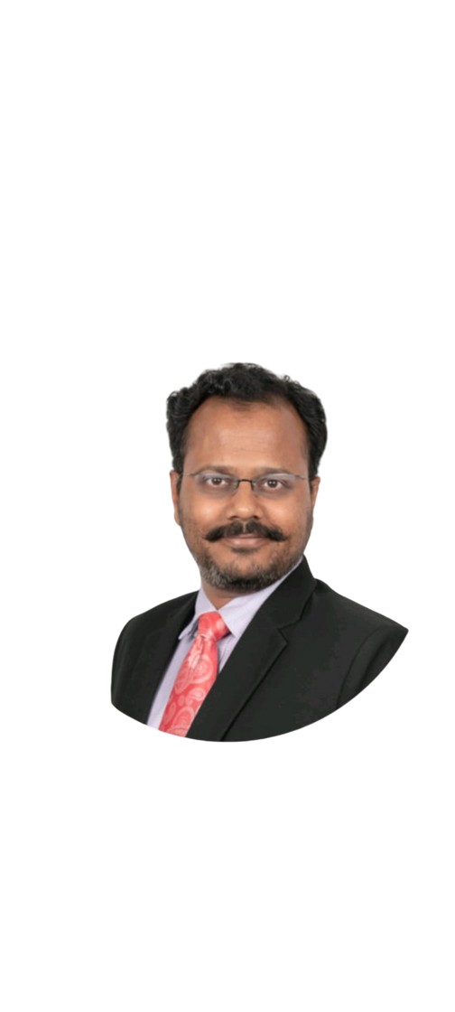
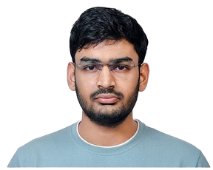
OUR TEAM
12
Subhashrao Deshpande
Mentor
Amol Phalke Coordinator
Ashutosh Barmukh
Aditya Ponkshe
Piyush Ozarde
Amol Sugandhi
Shashishekhar Chaugule
Ishant Deshmukh

Slide 14

AREAS OF CONTRIBUTION
13
13
1. Acting as mentors for research interns
2. Helping us in conducting and contributing to research projects related to surveys
3. Giving presentations on socially relevant topics of your expertise
4. Writing blogs, articles on socially relevant topics
5. Becoming part of study groups, events like – samajik shastra katta
6. Coming up with ideas, projects regarding national issues
7. Giving leads for organising courses
8. Funding

Slide 15

14
Contact Us
Address
You can come up with your own interesting inquiry questions related to society, and we can explore what we can do together about them...
510, Sadashiv Peth, Pune - 411030
Phone
020-24207116, 9850572580
Email
ssak@jnanaprabodhini.org
Visit us @
https://www.jnanaprabodhini.org/social-sciences-study-centre/

